Slide 1

GLOBAL TRENDS IN ECONOMIC AND HEALTH INDICATORS
Beginner’s Python for Engineers
Final Project: Group 14
  Members:
  Dang Ngan
  Devi Pirya
  Joonas Nivala
  Nguyen Khang

Slide 2

AGENDA
Introduction
Datasets
Task Division
Insights
Conclusion

Slide 3
INTRODUCTION
Our project’s focus:
  Global trends in economic and health indicators from 2000 to 2015.
  Variables: GDP and healthcare expenditure (as %GDP), average life expectancy and adult mortality rates.
We aim to answer the questions:
  To what extent do economic factors correlate with certain health indicators on a continental level?
  How does a significant economic downturn, such as the global crisis in 2008, affect the health outcomes of continents?

Slide 4
DATASETS
World Bank Data on Countries
(Base dataset)
Health and Demographics Dataset
(Additional dataset)
Usage objectives: Gross Domestic Product (GDP) and the percentage of GDP allocated to healthcare across continents (2000 to 2015)
Targeted columns: 'Country Name', 'Year', 'GDP', 'Health Expenditure (% GDP)', 'Continent Name
Usage objectives: Average life expectancy and adult mortality rates across countries, organized by continent (2000 to 2015).
Targeted columns: 'Country', 'Year', 'Life expectancy', 'Adult Mortality’

Slide 5

TASK DIVISION
Dang Ngan: Cleaning and analyzing the base dataset
Devi Pirya: Cleaning and analyzing the additional dataset
Joonas Nivala: Data visualization
Nguyen Khang: Data visualization

Slide 6
TASK DIVISION
Cleaning the datasets:
  Merge datasets for uniformity in characteristics (such as countries’ continent names).
  Make a copy merged file and work separately to ensure comprehension and precision.
  Group countries by continent and year using ‘groupby()’ and start basic calculations with ‘agg()’.
  Final merge includes key characteristics per continent over the period.
Data visualization:
  Line graphs are used to visualize the chosen variables from 2000 to 2015 (time series).
  Using linear regressions to show correlations between economic factors and health indicators.
  Bar plots (for comprehension purpose) and box plots are used to represent the confidence intervals of different variables in 2008.

Slide 7
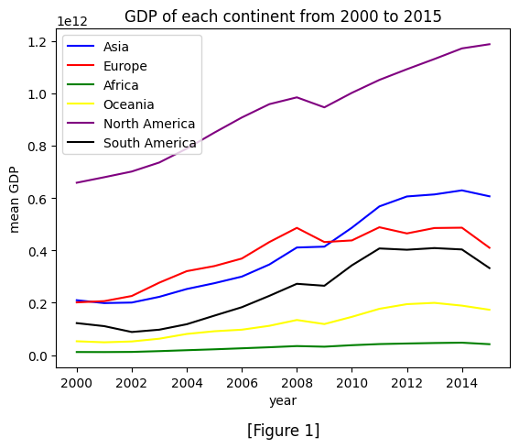
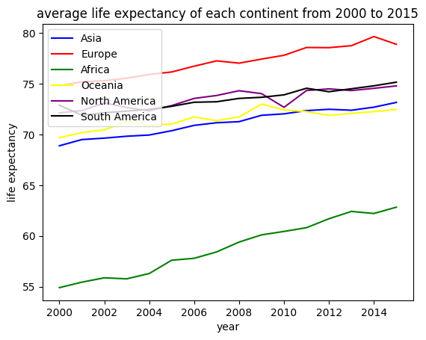
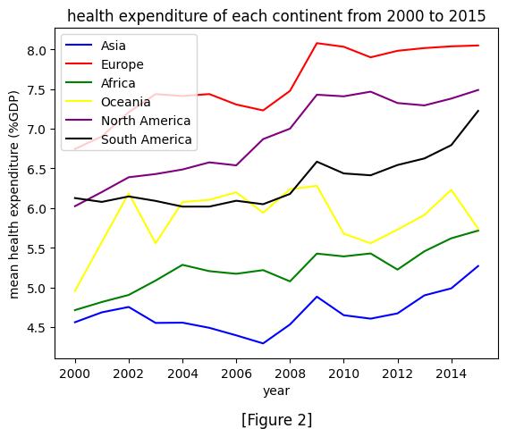
INSIGHTS
GDP positively correlates with life expectancy:
  Strongest: Africa (0.98)
  Weakest: Oceania (0.78)
Health expenditure fairly positively correlates with life expectancy:
  Strongest: Europe (0.88)
  Weakest: Oceania (0.41)

Slide 8
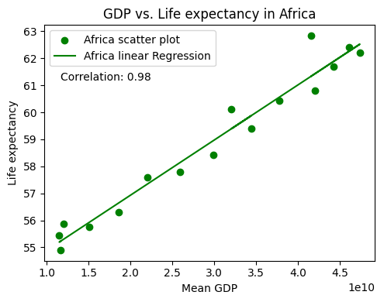
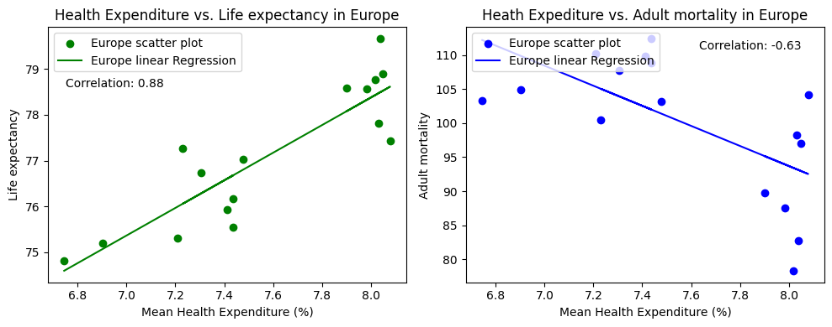
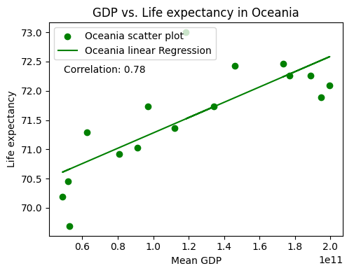
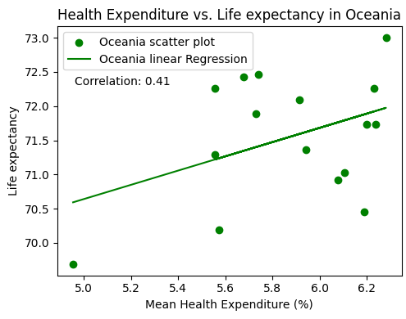
INSIGHTS
GDP positively correlates with life expectancy:
  Strongest: Africa (0.98)
  Weakest: Oceania (0.78)
Health expenditure fairly positively correlates with life expectancy:
  Strongest: Europe (0.88)
  Weakest: Oceania (0.41)

Slide 9
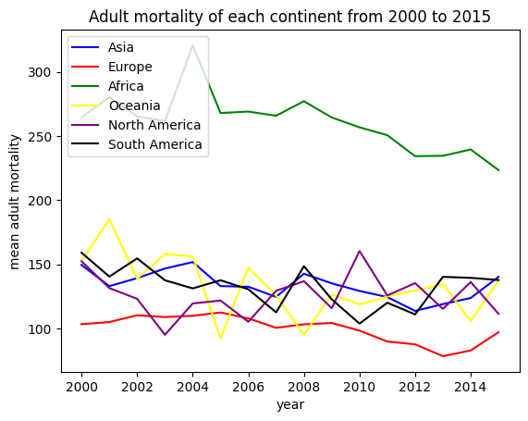
INSIGHTS
GDP fairly correlates negatively with adult mortality, weakening at higher GDP levels.
  Strongest: Europe (-0.68)
  Weakest: North America (-0.14)
Health expenditure slightly correlates negatively with adult mortality.
  Strongest: Europe (-0.63)
  Weakest: North America (-0.09)

Slide 10
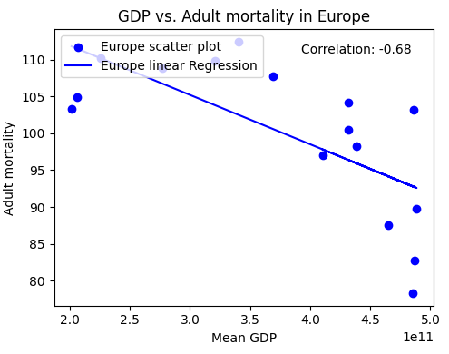
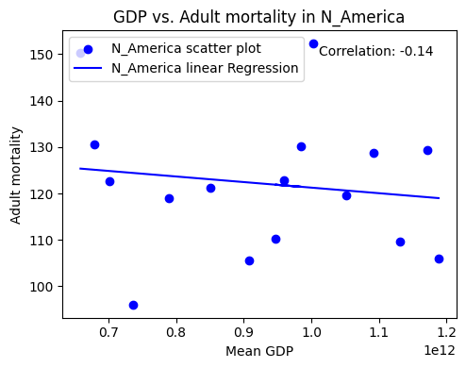
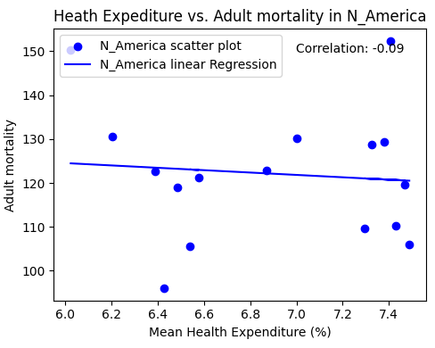
INSIGHTS
GDP fairly correlates negatively with adult mortality, weakening at higher GDP levels.
  Strongest: Europe (-0.68)
  Weakest: North America (-0.14)
Health expenditure slightly correlates negatively with adult mortality.
  Strongest: Europe (-0.63)
  Weakest: North America (-0.09)

Slide 11
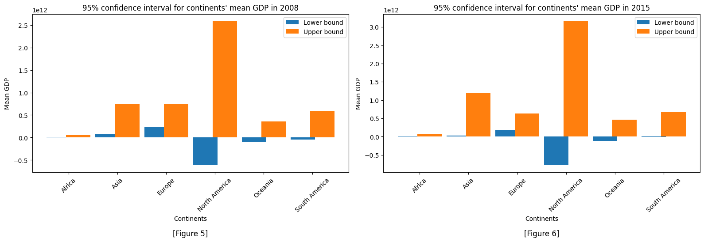
INSIGHTS
No clear trends in life expectancy and adult mortality, except for stability.
GDPs’ confidence interval generally decreased, with North America and Asia as outliers.
Despite the global crisis, GDP maintained an upward trajectory.

Slide 12
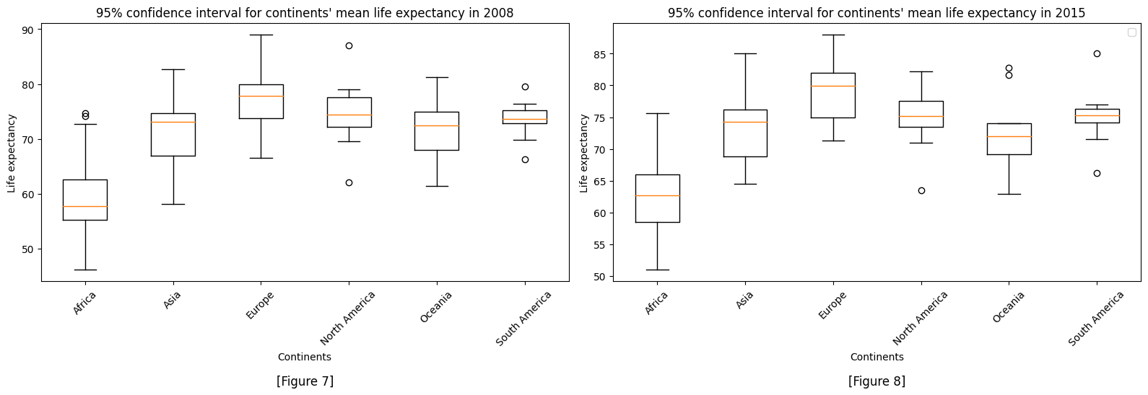
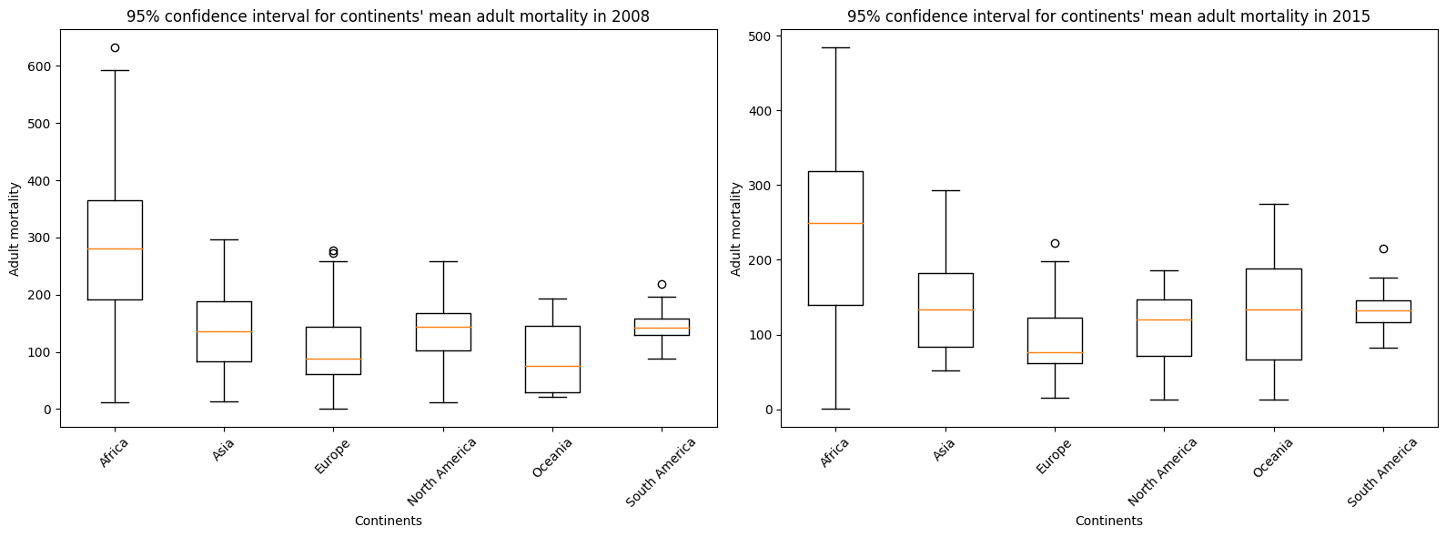

Slide 13
CONCLUSION
Average GDP exhibits a clear positive correlation with health indicators, while health expenditure shows inconsistency in predicting the health conditions of a continent.
  Health expenditure may not directly translate to better health, other socioeconomic factors…
Higher mean GDP and health expenditure on continents generally correlate with higher life expectancy and lower adult mortality.
The correlations of both economic variables are more pronounced in life expectancy than in adult mortality.
  Quality of healthcare and living standards directly impact life expectancy.
  Various non-economic factors influence adult mortality, such as road safety and crime rates.

Slide 14
CONCLUSION
To assess the health status of a continent from 2000 to 2015, mean GDP proves to be a more reliable indicator compared to health expenditure, with the exception of Oceania.
  Indirect improvement of living standards
  Difference in healthcare systems’ effectiveness
  External factors: environment, socioeconomic factors…
During an economic downturn, assessing the impact of certain economic factors on continental health using long-term health indicators might not be suitable.
  Long-term indicators may not capture rapid changes or short-term fluctuations accurately.
  Resilience of healthcare systems, public health interventions, and social safety nets during crises…

Slide 15

RECOMMENDATION
For a comprehensive understanding of the impact of economic conditions on health indicators, short-term health indicators may provide valuable insights.
  For examples: healthcare utilization rates, disease prevalence trends, vaccination coverage rates, and more.

Slide 16


